Slide 1
Computer Programming Mid-term Test 2

Slide 2
Problem 5-6
How to read code?
Start from Main function
Code tracking

Slide 3
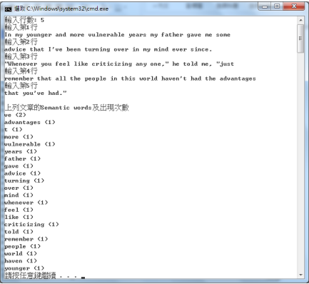
Problem 7
Expected Output
To summarize the question:
請寫一個程式，輸入文句，從中找出 semantic words，計算各 semantic word 出現次數，並將結果依出現次數，由高而低排序顯示於主控台螢幕
A bird in the hand is worth two in the bush

Slide 4
Problem 7
Expected Output
What function we need?
Handling user input <optional>
Split article into words.
Remove comma, period, etc.
Judge if a word is semantic words
Remove word from list if it is not semantic word
Counting frequency of semantic word
Sort semantic words by frequency
Print out
Given
InputArticle
ProcessLine
IsAStopWord

Slide 5
Problem 7
// Handling user input article = InputArticle() // Split article into words words = string[article.length][] totalWord = 0 for i=0 to words.length line = article[i] word = ProcessLine(line) words[i] = word totalWord+= words.length // Judge if a word is semantic words semanticWrods = new string[totalWord] pointer = 0 foreach word in words for i=0 to word.length if not IsAStopWord(word[i]) semanticWrods[pointer] = word[i] pointer+=1 //Counting frequency of semantic word name = string[semanticWrods.length] freq = int[semanticWrods.length] pointer = 0 foreach str in words { int response = inArray(str, name, pointer); if (response != -1) { freq[response] += 1; } else { name[pointer] = str; freq[pointer] = 1; pointer++; } } // Sort semantic words by frequency sort(name, freq) //Print out print(name, freq)
Expected Output
Pseudo code

Slide 6
Problem 7
string[] name = new string[words.Length]; int[] freq = new int[words.Length]; int pointer = 0; // method 1 //count foreach (var str in words) { int response = inArray(str, name, pointer); if (response != -1) { freq[response] += 1; } else { name[pointer] = str; freq[pointer] = 1; pointer++; } } // bubble sort for (int i = 0; i < pointer; i++) { for (int j = i; j < pointer; j++) { if (freq[i] < freq[j]) { swap(ref freq[i], ref freq[j]); swap(ref name[i], ref name[j]); } } } // print for (int i = 0; i < pointer; i++) { Console.WriteLine("{0}: {1}", name[i], freq[i]); }
public static int inArray(string str, string[] arr, int pointer){ for (int i = 0; i < arr.Length; i++) { if (arr[i] == str) { return i; } if (i >= pointer) { return -1; } } return -1; }
Intuitive
Counting frequency of semantic word
Sort semantic words by frequency

Slide 7
Problem 7
Improvement: Testing
Unit Test
Integration Test
Test Case # | Test Case Description | Test Step | Test Data | Expected Result | Actual Result | Pass/Fail
1 | Check if response is valid while str in array | Pass str, array, pointer to function in array | Str: “test” Arr: [“example”, “for”, “unit”, “test”, “case”, null, null] Pointer: 5 | 3 | 3 | pass
Example for Function inArray
Test Case # | Test Case Description | Test Step | Test Data | Expected Result | Actual Result | Pass/Fail
2 | Check if response is valid while pointer is invalid | Pass str, array, pointer to function in array | Str: “Hi” Arr: [“example”, “for”, “unit”, “test”, “case”, null, null] Pointer: 999 | -1 | -1 | pass

Slide 8
Problem 7
Improvement: Poka-yoke
Handling error/poor data flow using assertion
Article must not be empty
Freq must be positive
Pointer must be positive
Debug.Assert(article.Length > 0);
Debug.Assert(freq.All(x => x > 0));
Debug.Assert(pointer >= 0);

Slide 9
Problem 7
Improvement: Efficiency
Hash table (both time and space complexity)
//method 2 SortedDictionary<string, int> hashtable = new SortedDictionary<string, int>(); foreach (var str in words) { if (hashtable.ContainsKey(str)) { hashtable[str] = hashtable[str] + 1; } else { hashtable.Add(str, 1); } } List<KeyValuePair<string, int>> list = hashtable.OrderByDescending(pair => pair.Value).ToList(); foreach (KeyValuePair<string, int> entry in list) { Console.WriteLine("{0}: {1}", entry.Key, entry.Value); }

